Slide 1
The Java programming language

Slide 2
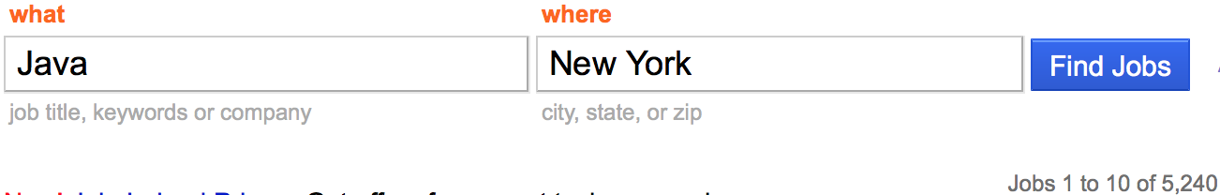

Why Java?
Popular programming language
Easy to learn
“Write once, run anywhere”

Slide 3
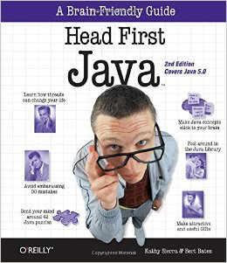
Going to be using Head First Java 2nd Edition as a reference

Slide 4
How do we write programs?
Source code -> Compiler -> Output (bytecode) -> read by machine

Slide 5
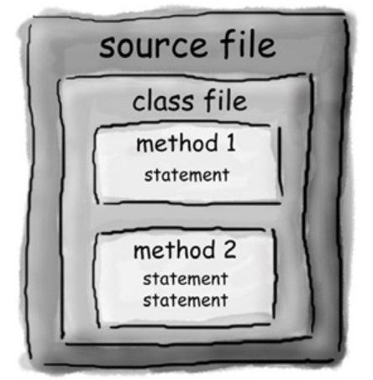
How is it structured?

Slide 6
Hello, World
Common first program

Slide 7
Things to cover
Printing
Comments
Variables
Working with Strings
How to get info from the user?
Boolean tests
If/else
Methods, user-defined, built-in
Loops
Arrays

Slide 8
Variables
boolean char byte short int long float double – primitives
String?
Name cannot start with number
Name cannot be a reserved keyword
Reference variable – will cover later

Slide 9
API provides an interface to do complex things, very easily
Think about accelerating a car with a pedal

